Slide 1

Hotel aggregator analysis

Slide 2

Table of content
Problem statement
Project objectives
Conclusions
Recommendations

Slide 3

PROBLEM STATEMENT
The goal of this work is to utilize Power BI to gauge a collection of hotel aggregator's listings. The dataset includes several factors availability, reviews, hosts, and listings. The objective is to create a comprehensive insights and infographics that indicate patterns, trends, and factors influencing listings' performance.

Slide 4
Project objectives
Geographical Insights:
Pricing and Availability Analysis
Host Performance
Review Scores and Guest Satisfaction
Property Type and Room Analysis

Slide 5
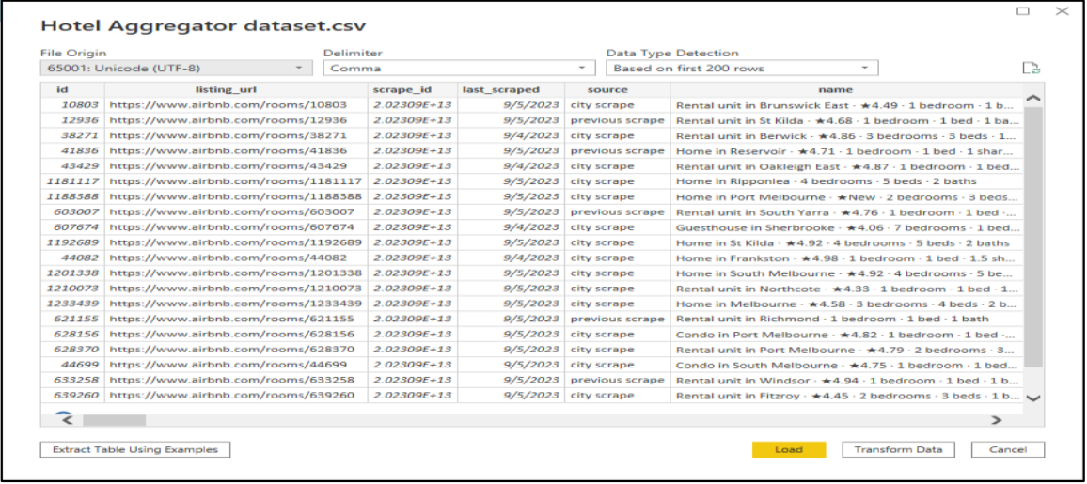
Project data

Slide 6
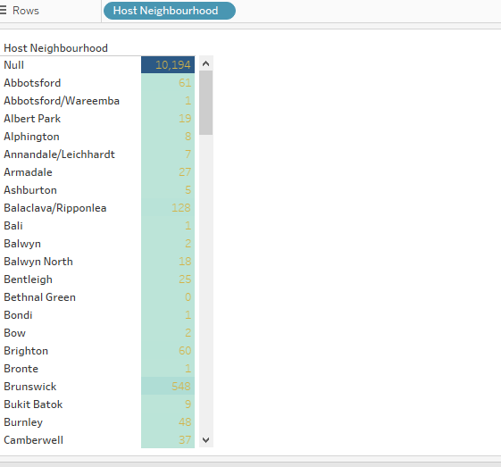

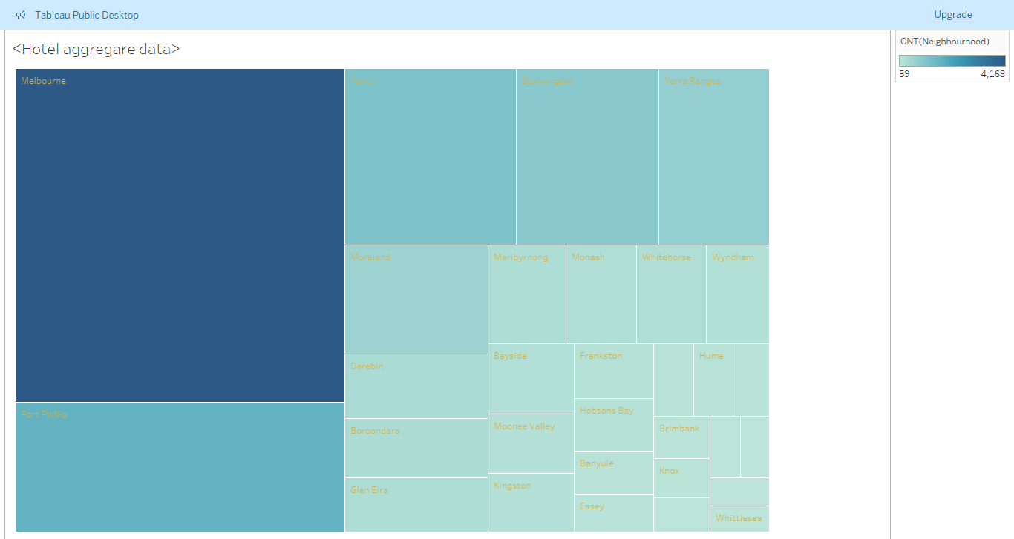
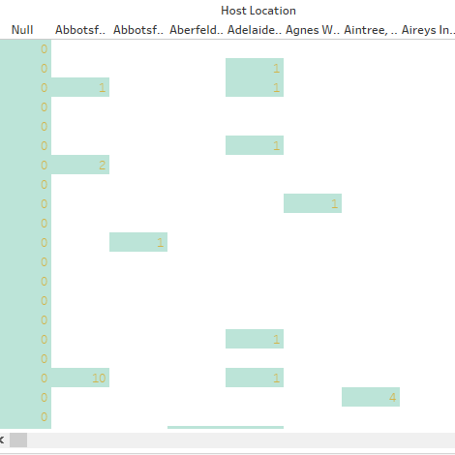
Geographical Insghits
.

Slide 7
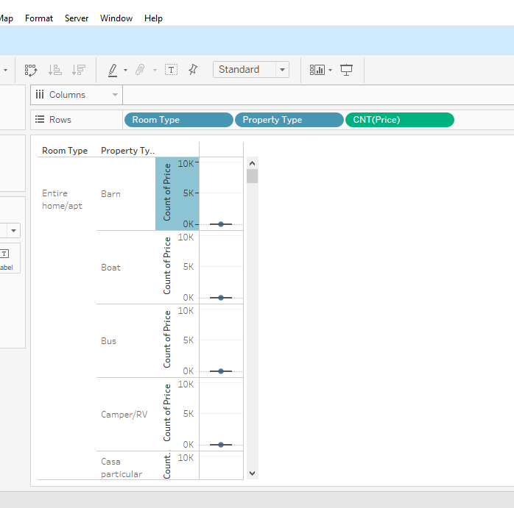
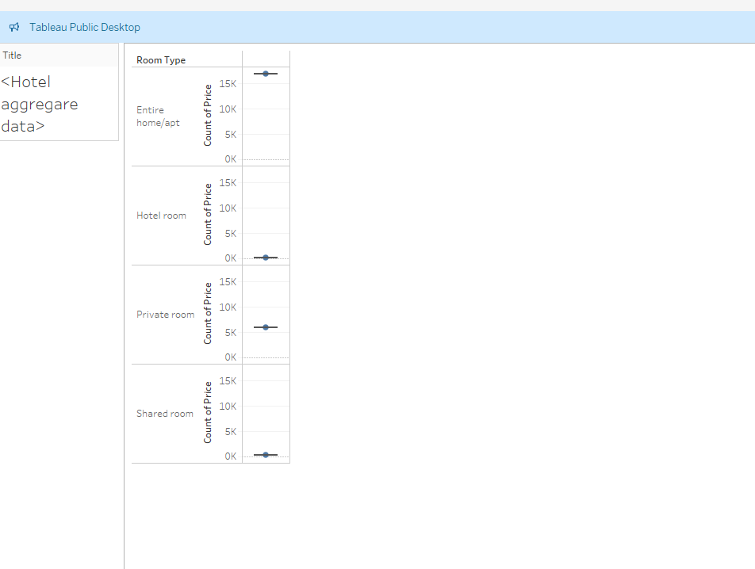
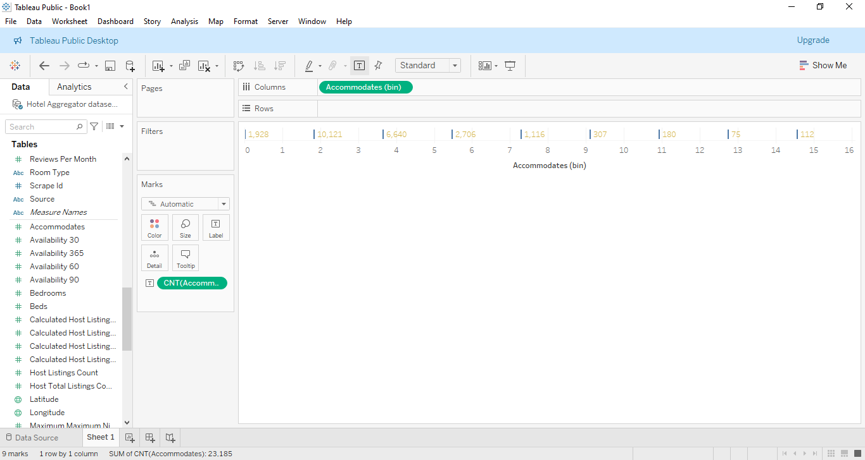
Price & Availability analysis

Slide 8
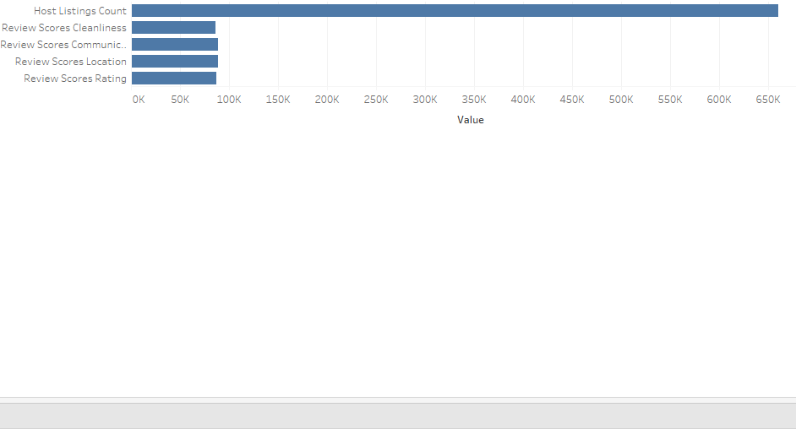
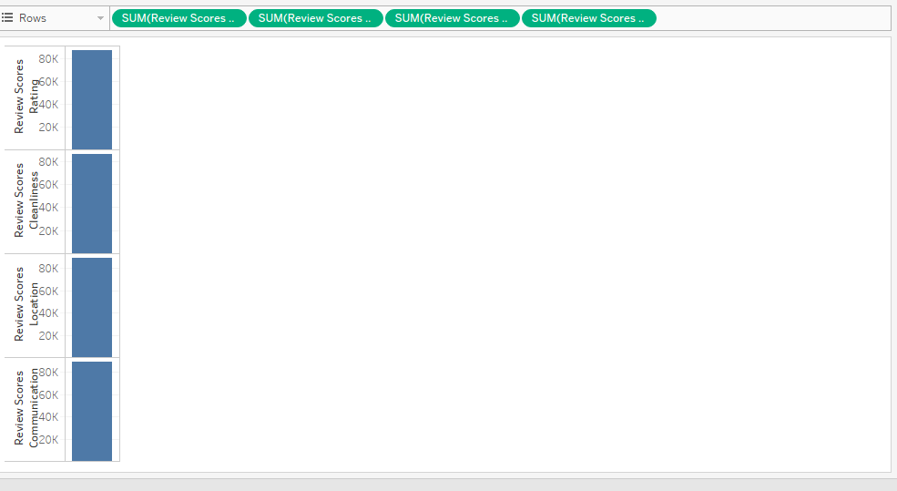
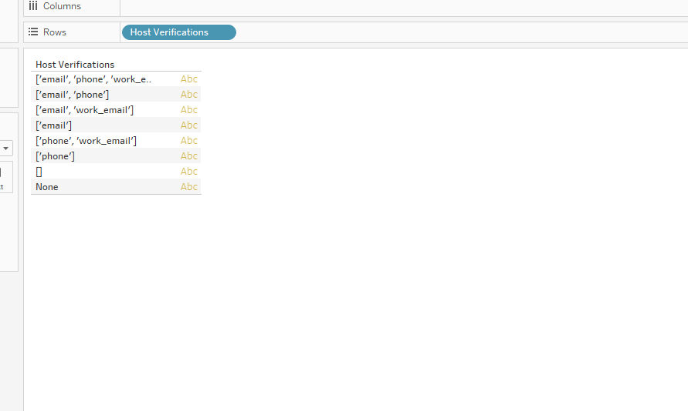
HOST PERFORMENCE

Slide 9
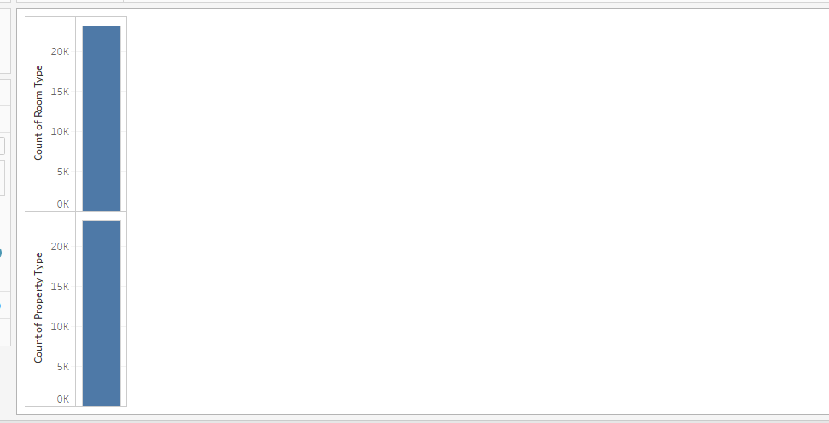
Property type and room analysis

Slide 10
Conclusions
Geographical insights: Provides insights into the distribution of listings in popular neighborhoods, host locations, and host neighborhoods. It shows where properties are concentrated, where hosts are based, and which areas are popular among hosts and guests.
• Pricing & availability analysis: It showcases average prices for different property types, room types, and based on accommodates. •
Host performance: Presents insights into host performance metrics such as host response time, host verification methods, and host status. By analyzing this data, one can understand the distribution of host response times, verification methods used by hosts, and the proportion of super hosts versus regular hosts.
• Review scores & guest satisfaction: It displays the relationship between review scores and host listing counts, host total listings count by year, and review scores based on property and room types. This data helps in understanding guest satisfaction levels, trends in review scores over time, and the impact of property and room types on guest experiences.
• Property type & room analysis: It presents the count of different property types and room types, showcasing the distribution of accommodation options.

Slide 11
Recommendations
Host Performance Optimization: Encourage hosts to maintain quick response times to enhance guest satisfaction. Promote the use of multiple verification methods to build trust with guests. Consider the benefits of achieving super host status for improved credibility.
• Pricing and Availability Strategies: Analyze pricing trends for different property and room types to set competitive rates. Adjust pricing based on accommodates to maximize revenue and occupancy. Monitor availability to capitalize on high-demand periods and adjust pricing accordingly.
Guest Satisfaction Enhancement: Focus on improving review scores by providing exceptional service and amenities. Track guest satisfaction levels over time to identify areas for improvement. Tailor property and room offerings to meet guest preferences and enhance satisfaction.
• Property and Room Type Management: Understand the popularity of different property and room types to optimize inventory. Diversify offerings based on demand for specific accommodation options. Utilize insights to enhance marketing strategies and target relevant customer segments.

Slide 12

Thank you!
wajeehawajji89@gmail.com
www.menorness.com

